Slide 1
Hotel Reservation Analysis with SQL
By Suprakrit Debnath Batch: MIP-DA-10

Slide 2
INTRODUCTION
Objective: Welcome to this presentation on analyzing a hotel reservation dataset to uncover insights into guest preferences, booking trends, and operational factors crucial to enhancing guest experiences and optimizing hotel operations.

Slide 3
Dataset Overview: The dataset we are exploring contains comprehensive information about hotel reservations, including booking details, guest demographics, stay duration, and booking status. By leveraging SQL queries, we aim to extract meaningful insights that will inform strategic decisions and improve overall service delivery.

Slide 4
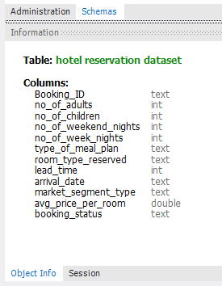
COLUMNS

Slide 5
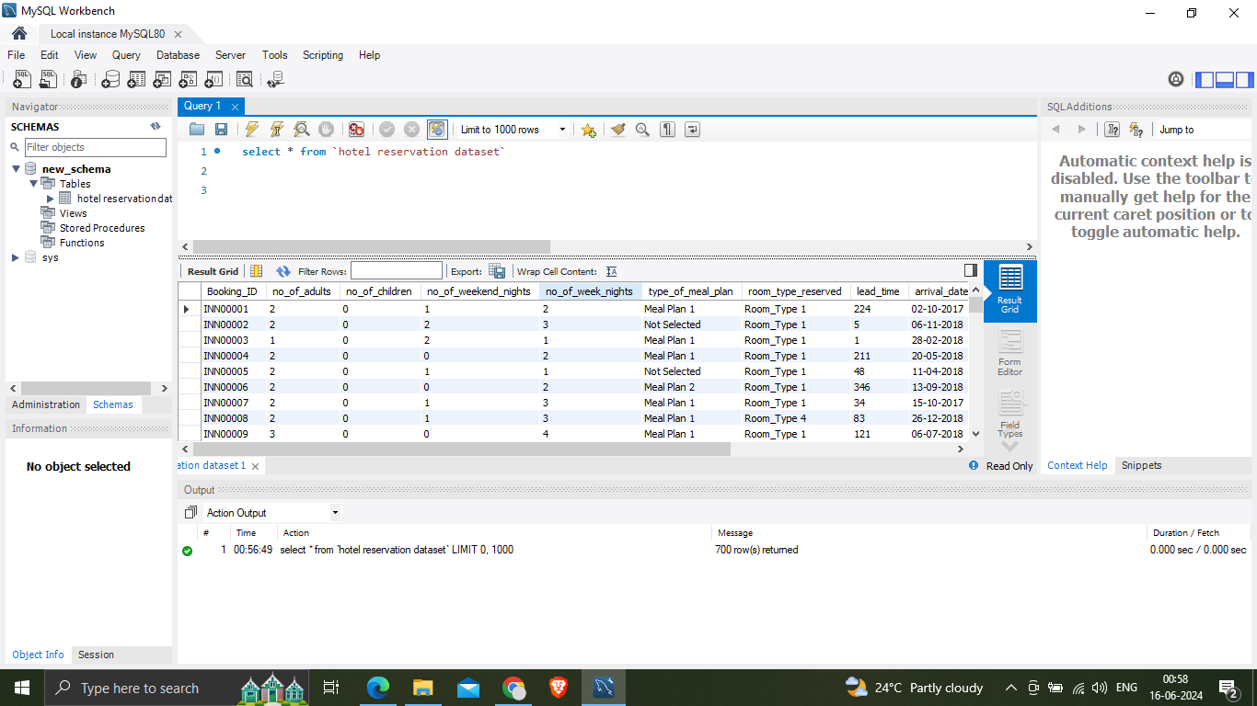

Slide 6
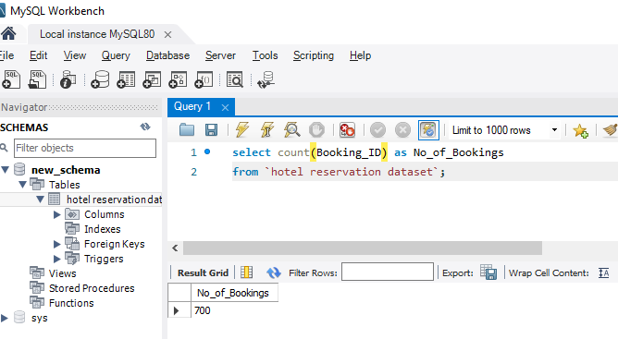
1. Total Number of Reservations

Slide 7
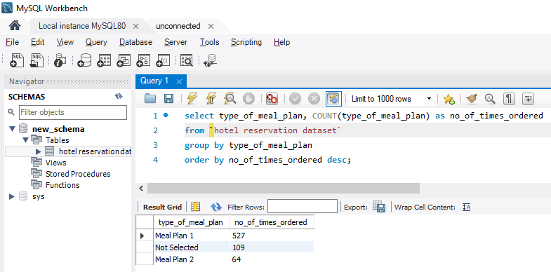
2. Most Popular Meal Plan

Slide 8
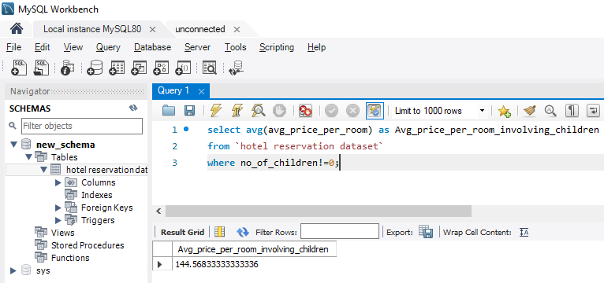
3. Average Price per Room for Reservations Involving Children

Slide 9
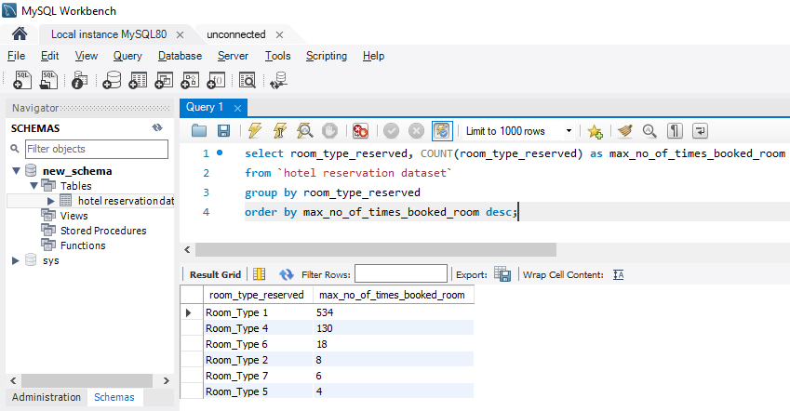
4. Most Commonly Booked Room Type

Slide 10
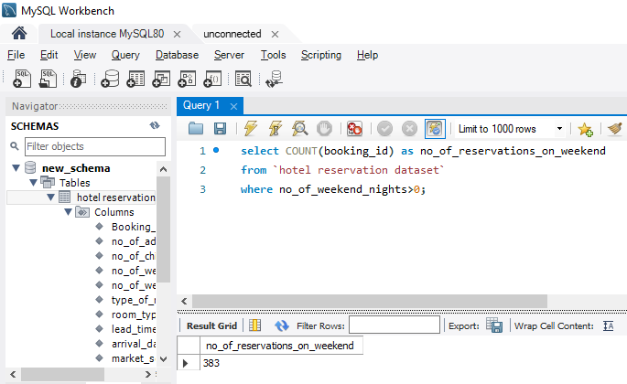
5. Reservations on Weekends

Slide 11
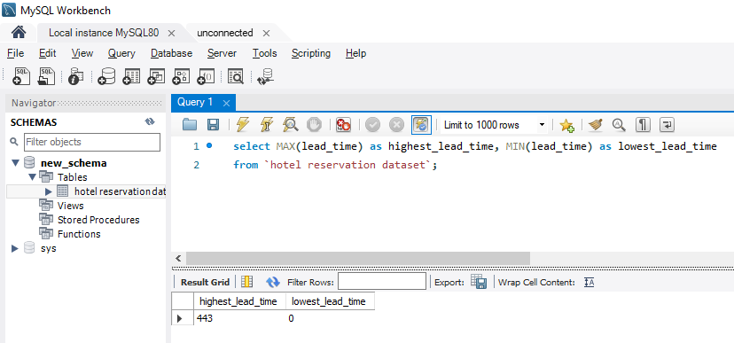
6. Highest and Lowest Lead Time

Slide 12
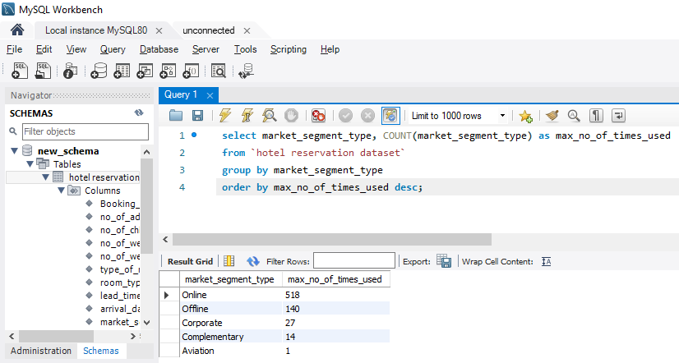
7. Most Common Market Segment Type

Slide 13
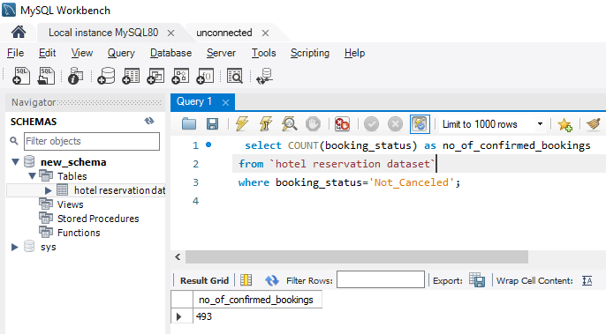
8. Reservations with Confirmed Booking Status

Slide 14
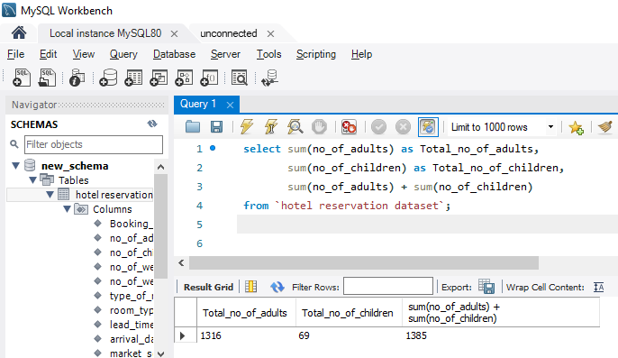
9. Total Number of Adults and Children

Slide 15
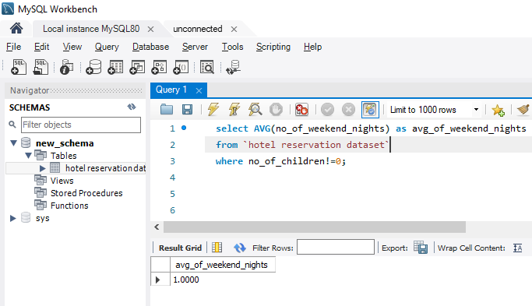
10. Average Weekend Nights for Reservations Involving Children

Slide 16
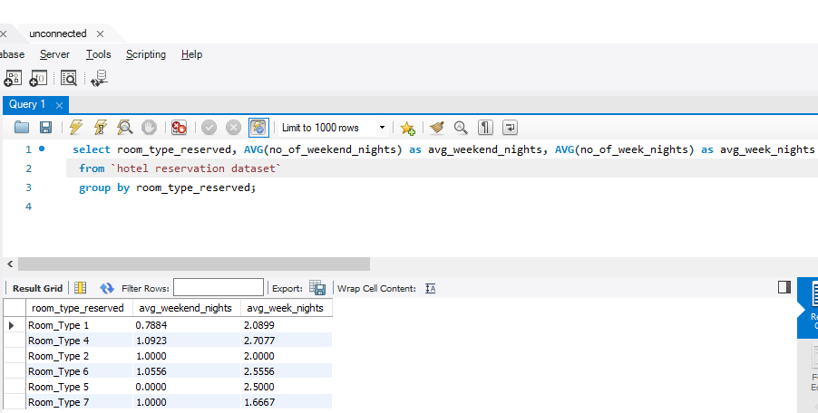
11. Average Nights Spent by Guests for Each Room Type

Slide 17
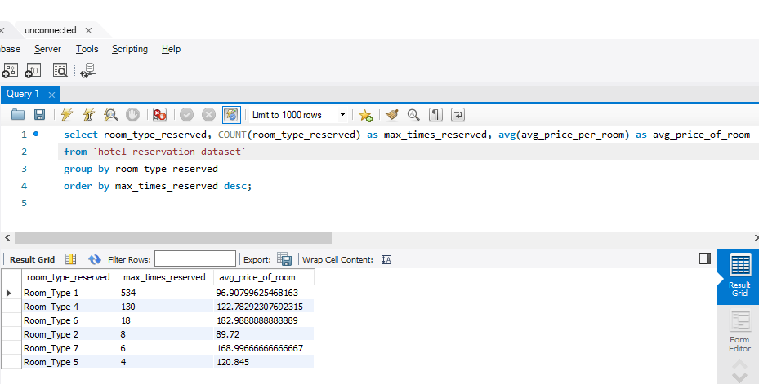
12. Most Common Room Type with Children and Average Price

Slide 18
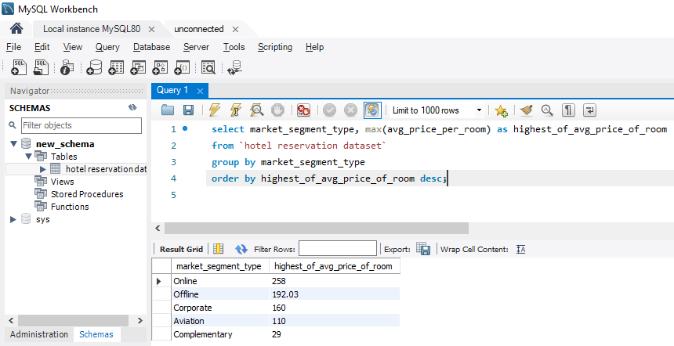
13. Market Segment Type with Highest Average Price

Slide 19
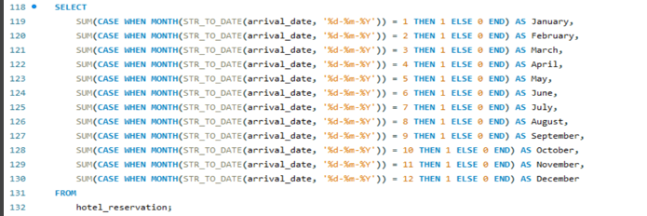
14. Reservations Made in Each Month of the Year

Slide 20
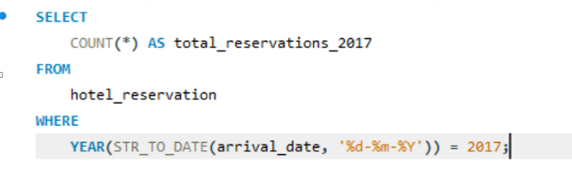

15. Reservations Made for a Specific Year

Slide 21
Conclusion
The hotel reservation dataset provides valuable insights into guest preferences and booking trends. Key findings include Meal Plan 1 as the favoured choice among guests, with Room type 1 being the most frequently booked. Analysis of lead times reveals varied booking behaviours, while the majority of reservations are confirmed, indicating robust booking management. Market segmentation highlights online, influencing pricing strategies. Reservations involving children command 125+ , reflecting family-friendly offerings. These insights equip hotels to refine marketing approaches and optimize guest experiences, ensuring competitive edge and guest satisfaction.

